Slide 1
Air, Aerodynamics, and Flight

Slide 2
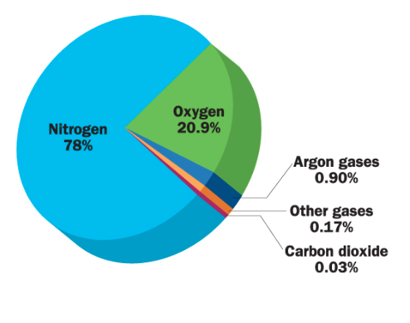
What is air?
Composition:
78% nitrogen
21% oxygen
1% Argon
trace amount of other gases
(carbon dioxide, water vapor, etc.)

Slide 3
What is air?
Air acts as a fluid (you can “pour” air)
Air can be compressed
Air takes up space
Air can exert pressure

Slide 4
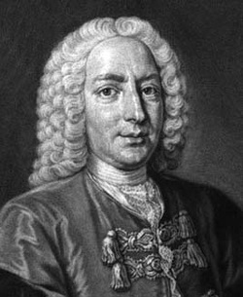
Daniel Bernoulli
Swiss mathematician
Studied fluids, and the result of altering pressure of fluids
Lived 1700-1782

Slide 5
Bernoulli’s principle states:
As the velocity of a fluid increases, the pressure exerted by that fluid decreases. As the velocity decreases, the pressure increases.
In other words…
high speed=lower pressure
low speed=higher pressure

Slide 6
Air, Aerodynamics, and Flight

Slide 7
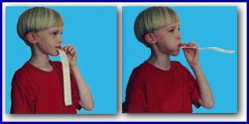
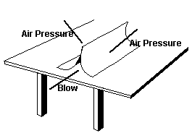
Bernoulli’s Principle in action:
The air moving through the paper is faster, meaning that there is LOW air pressure inside the tent. The air outside has HIGH air pressure, and is exerting this high pressure on either side of the tent, making it cave in
The air moving ABOVE the strip is FASTER, this means that there is lower pressure on top, and HIGH pressure underneath. The air exerts this pressure upwards from underneath the paper, making it straighten out

Slide 8
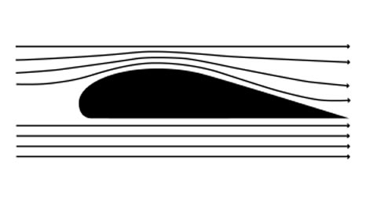
What does that have to do with airplanes?
The shape of an airplane wing is crucial in making it fly
Because of the shape of the wing, the air moves FASTER over the top of the wing, and SLOWER under it
If the air moves faster above the wing, Bernoulli’s principle states that the air pressure is LOW.
That means the air pressure below the wing must be HIGH, and the air exerts pressure on the wing to make it go up.

Slide 9
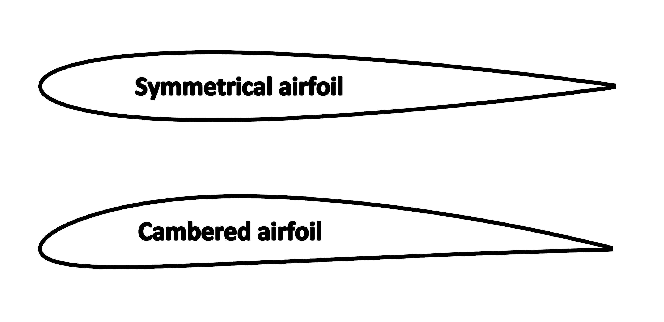
Airfoil
a structure with curved surfaces designed to give the most favorable ratio of lift to drag in flight
AKA: airplane wings

Slide 10
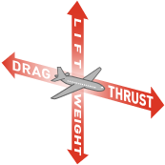
Forces of Flight
Lift is the force that acts at a right angle to the direction of motion through the air. Lift is created by differences in air pressure.
Thrust is the force that propels a flying machine in the direction of motion. Engines produce thrust.
Drag is the force that acts opposite to the direction of motion. Drag is caused by friction and differences in air pressure.
Weight is the force of gravity. It acts in a downward direction—toward the center of the Earth.

Slide 11
Opposites...
Gravity is the force that naturally pulls object toward each other
For a plane to fly, it must have sufficient LIFT to overcome GRAVITY, or its own weight.
Likewise…
For a plane to fly, it must have sufficient THRUST to overcome DRAG

Slide 12
Ways to overcome drag:
More thrust
In an airplane, thrust, or forward motion, is provided by the engine
Increase the thrust by having a larger engine, or a more powerful engine
Streamlining
Streamlining reduces pressure drag (which is when air flowing past an object pushes harder against the front than the back).
HOWEVER, streamlining usually means making the surface longer, which can increase the friction (which can cause drag)

Slide 13
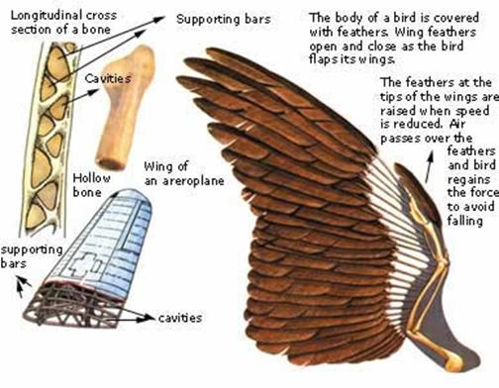
Flight in birds
Shape of wing
Hollow bones
Retractable landing gear
Streamlined, smooth feathers

Slide 14
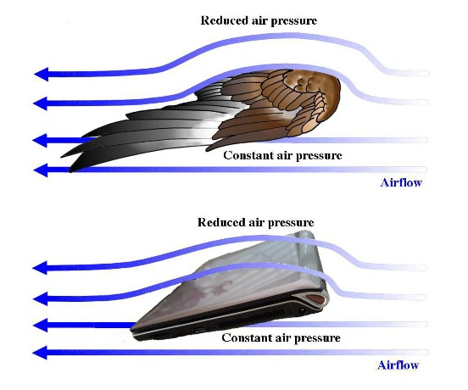
Shape of wing

Slide 15
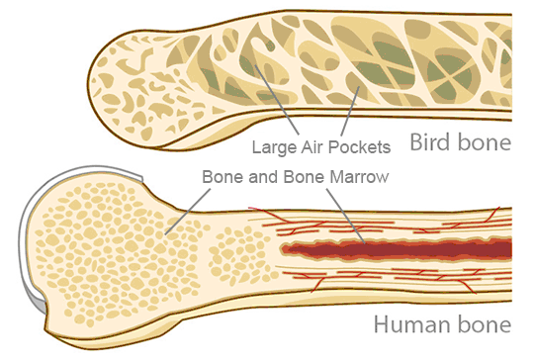
Hollow bones

Slide 16
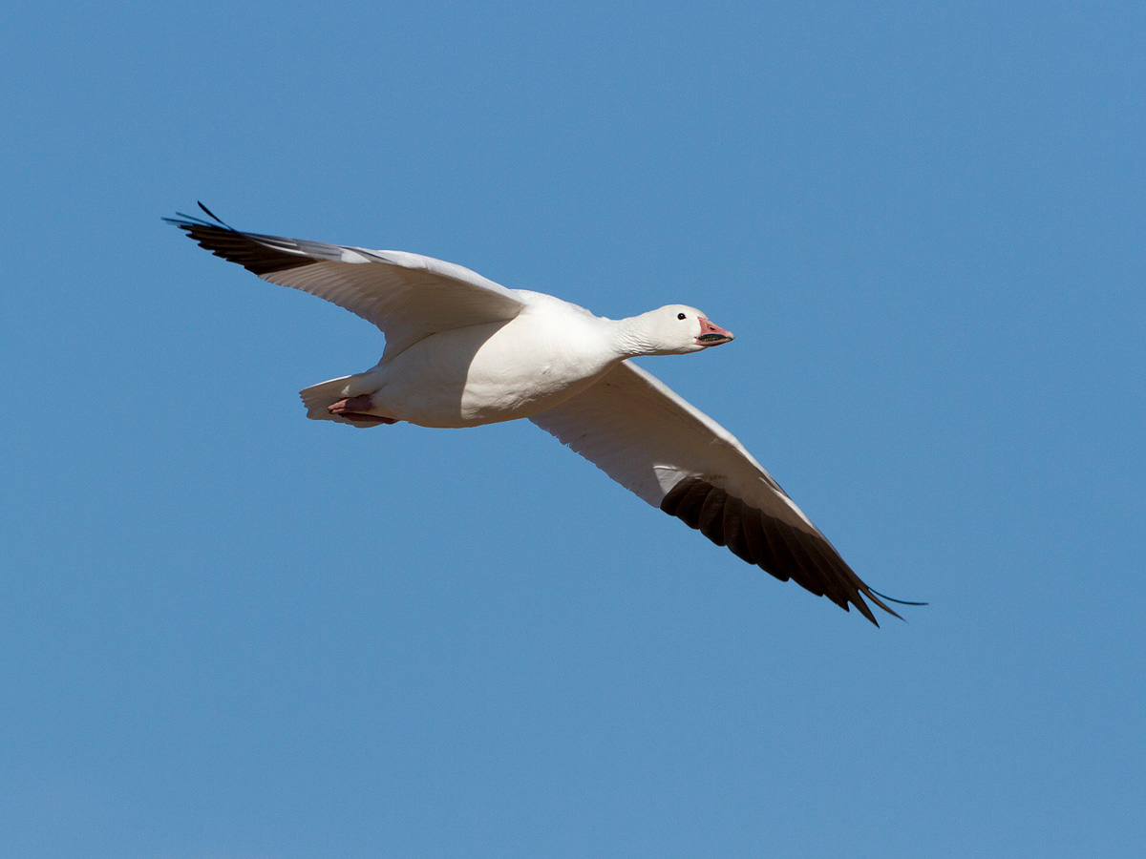
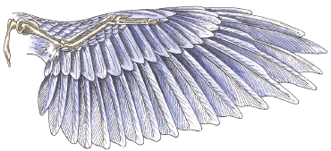
Retractable landing gear
Lightweight, smooth feathers

Slide 17
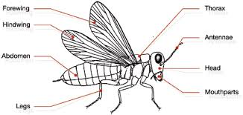
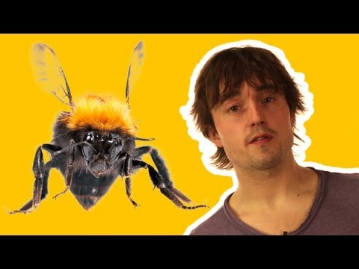
Flight in insects
When a bee zips across your garden, it blurs by at jet speed and turns on a dime
When a fly zooms through your kitchen and sniffs a possible snack, it can stop short in midair and hover like a helicopter

Slide 18
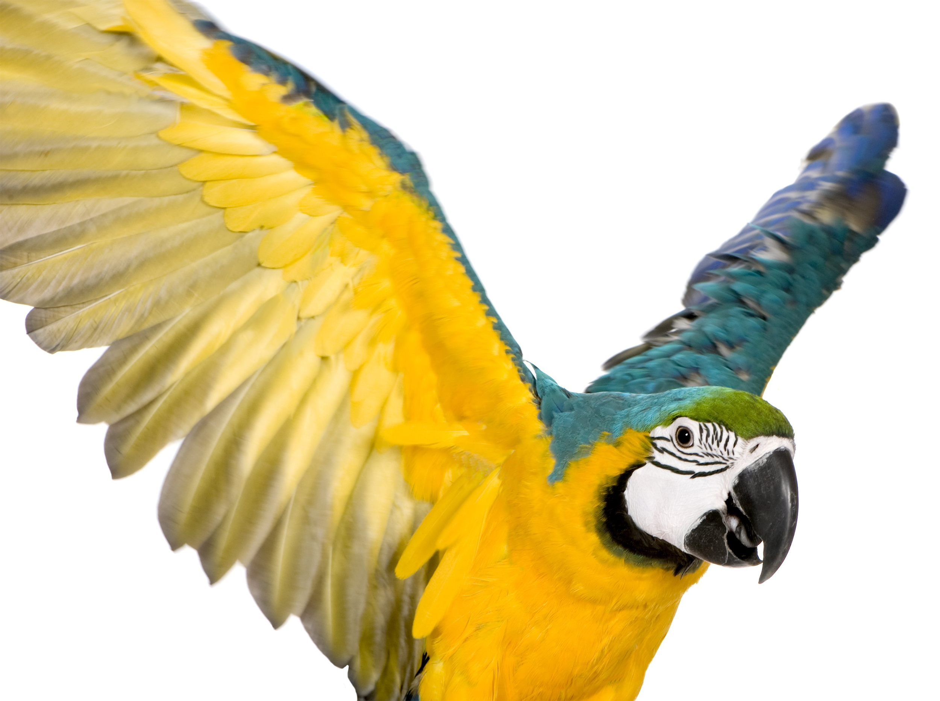
Animals and thrust
A bird generates thrust by flapping its wings. While it often looks like birds are flapping their wings up and down only, the angle of the wing causes forward motion aka, thrust.
The muscles a bird uses to generate thrust are located in their chest

Slide 19
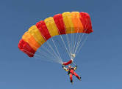
Parachutes
A parachute is a device used to slow down an object that is falling towards the ground.
There are two forces acting on the falling person:
Gravity (Downwards)
Air resistance (Upwards)
Without a parachute, the gravity is more than air resistance. However, as the parachute opens, the air resistance increases. Now, air resistance is more than gravity.
This slows down the parachute and the person can land safely on the ground.

Slide 20
Parachutes
Gravity is the force that pulls things towards the ground
The earth’s pull makes the objects speed up by 9.8 meters per second, every second.
If we dropped a weight and a piece of paper, gravity would pull them to the earth at the same rate

Slide 21
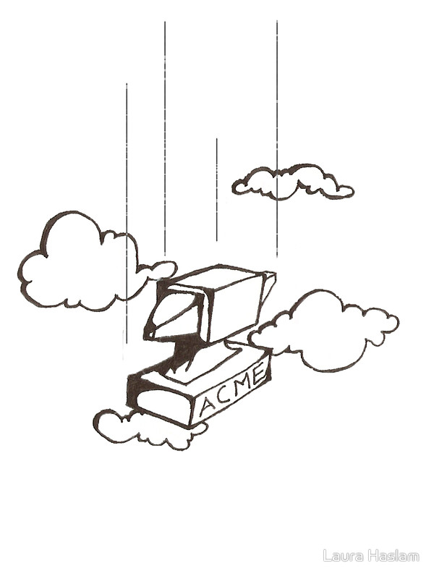
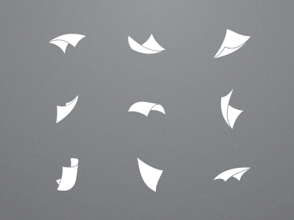
The reason the weight and paper don’t land at the same time is because of air resistance
The paper has more surface area than a weight, and therefore has more air resistance, or drag (the force acting against gravity)

Slide 22
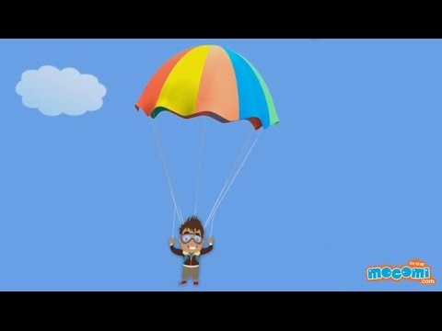
Parachutes

Slide 23
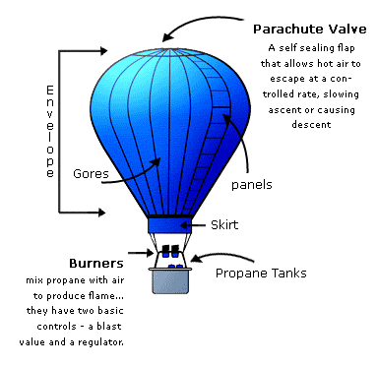
Hot Air Balloons
A hot air balloon is made up of 3 main parts:
The Envelope
The actual fabric balloon which holds the air
The Burner
The unit which propels the heat up inside the envelope
The Basket
Where the passengers and pilot stand

Slide 24
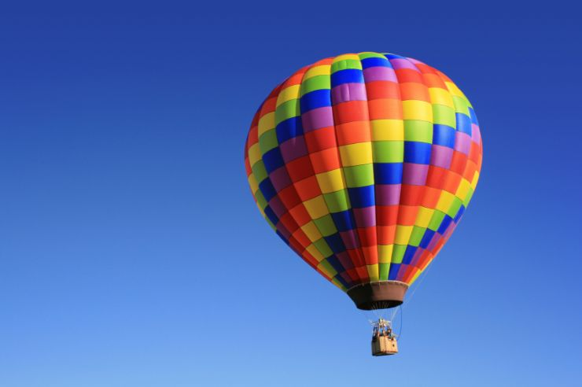
How do they move?
1 - To move the balloon upwards - The pilot fires the flame up into the envelope (balloon). The more you open the valve, the bigger the flame to heat the air, the faster the balloon rises.
2 - To move the balloon downwards - If the pilot wants to bring the balloon down he simply pulls a cord to open a valve that lets hot air escape, decreasing the inner air temperature. This cooling of air causes the balloon to slow its ascent.

Slide 25
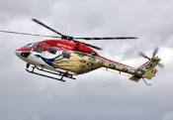
Helicopters
A helicopter is a type of airplane known as a vertical takeoff and landing craft (VTOL).
The helicopter does not have wings like an airplane. Instead it has long blades or rotors. These are attached to a shaft in the engine. It also has a tail on it with smaller rotors to keep the helicopter from rotating
The pilot uses a foot pedal and two specialized pitch sticks to control the helicopters direction.

Slide 26
Gliders
A glider is a special kind of aircraft that has no engine.
In flight, a glider has three forces acting on it as compared to the four forces that act on a powered aircraft.
What are the four forces of flight?
What are the three forces of flight that act on a glider?

Slide 27
Gliders
Both types of aircraft are subjected to the forces of lift, drag, and weight. The powered aircraft has an engine that generates thrust, while the glider has no thrust.
In order for a glider to fly, it must generate lift to oppose its weight. To generate lift, a glider must move through the air.

Slide 28
Roll, Pitch and Yaw
http://howthingsfly.si.edu/media/airplane-axes
Airplanes are controlled along three axes: the longitudinal axis (front to back) ROLL, the lateral axis (wingtip to wingtip) PITCH, and the vertical axis (top to bottom) YAW.

Slide 29
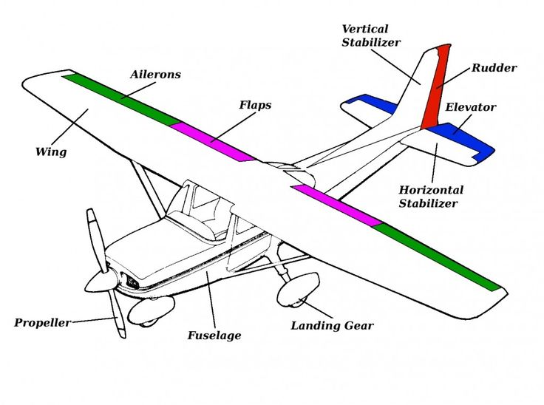
Parts of an airplane

Slide 30
Parts of an airplane
Vertical stabilizer keeps the nose of the plane from swinging from side to side, which is called yaw.
The horizontal stabilizer prevents an up-and-down motion of the nose, which is called pitch.
The outboard hinged part of the wing is called the aileron; it is used to roll the wings from side to side.The ailerons are hinged on the wings and move downward to push the air down and make the wing tilt up. This moves the plane to the side and helps it turn during flight.

Slide 31
Parts of an airplane
The elevators are found at the rear of the plane. They can be raised or lowered to change the direction of the plane's nose. The plane will go up or down depending on the direction of that the elevators are moved.
The rudder at the back of the plane moves left and right to control the left or right movement of the plane.
The fuselage or body of the airplane, holds all the pieces together. The pilots sit in the cockpit at the front of the fuselage.

Slide 32
Airplane vs spacecraft
Aircraft fly through air and spacecraft fly in space.
In space, there is no air, so a spacecraft cannot be designed the same as an aircraft. To get into space, spacecraft need rocket boosters. They don’t need wings for flying.

Slide 33
Airplane vs spacecraft
Spacecraft needs to rely on thrust to move around safely.
Spacecraft have to carry their own air along in the form of oxidizer, since there is no air to make the engines work. That's why jet engines can't work in space, so rocket engines must be used instead.

