Slide 1
Evidence and Investigation

Slide 2
What is evidence?
Any piece of information, physical markings, or material objects that give people a reason to believe something,
Common types of physical evidence at crimes scenes include:
Tracks/prints
Fingerprints
Handwriting (ransom notes)
Fabric Samples

Slide 3
What is testimony?
A form of evidence given by a witness who makes a solemn statement or declaration of fact. Testimony may be oral or written. Testimony may include identifying a suspect’s:
hair colour
eye colour
height
shape of face
weight
distinguishing marks (tattoos, scars)

Slide 4
Tracks
Footprints, tire tracks, animal tracks

Slide 5
Footprints
Size and Depth
Shoe size of the person who made the tracks
Depth lets us know how heavy the person is who made the track
Direction
What way is the person travelling
Speed/Gait
Distance between footprints lets us know:
If the person is running or walking
How long the person’s legs might be
Tall or short adult; adult or child
Tread pattern
Some shoes have very specific soles, or may have markings on them (eg: sports brands such as adidas, or Nike)

Slide 6
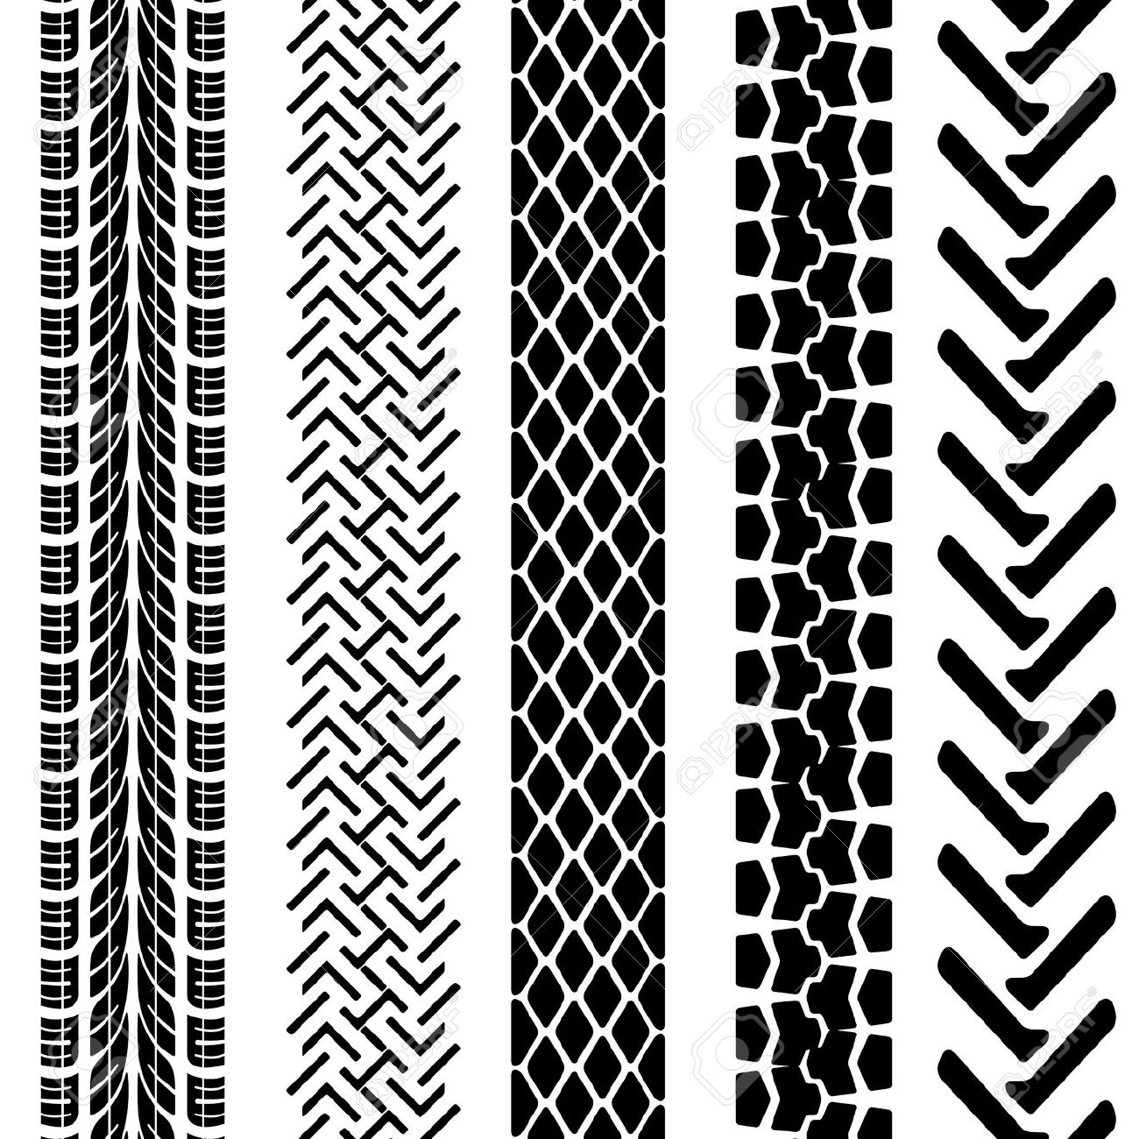
Tire Tracks
Tread pattern
Some tires have specific treads that can indicate brand
Can tell us if the tires are newer or older
Can tell us if it is a wheeled vehicle, or a vehicle on a track, like a snowmobile
Width of tire track
Can tell us the type of vehicle that left the track. Eg: Truck or bicycle?
Width between tires
Can tell us the type of vehicle that left the track. Eg: Truck, or ATV?
Depth of track
How heavy is the vehicle? Eg: if a bicycle track is very deep, perhaps there was more than one person on it

Slide 7
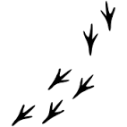
Animal Tracks
Type of animal
Dogs and cats leave four toes and a pad, but dog prints leave a claw
Deer tracks appear in pairs and alternate between right and left
Bird tracks alternate between left and right and there may be gaps where the bird hopped or took flight

Slide 8
Fingerprints

Slide 9
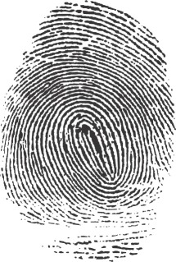
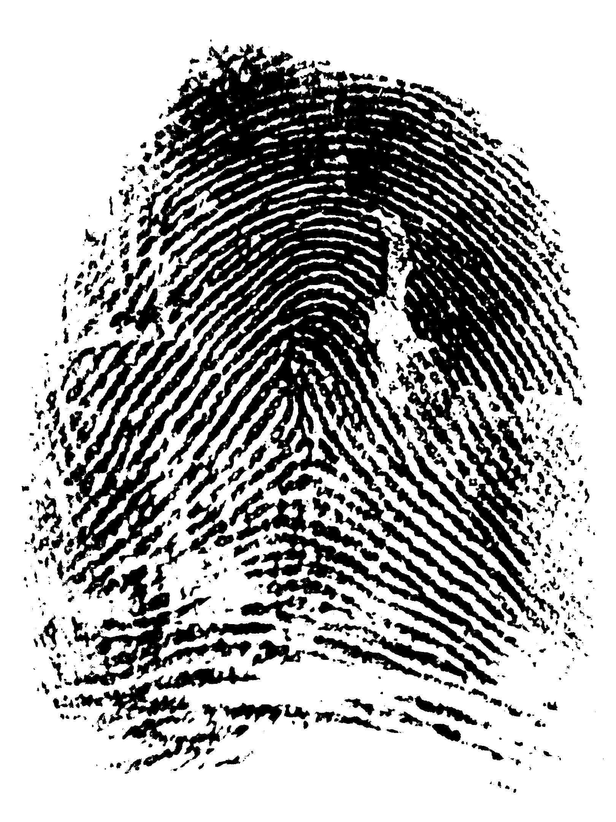
Why is fingerprinting important?
Conclusive evidence. No two fingerprints are alike!
Can be put into four groups:
Arches
Whorls
Loops
Composite

Slide 10
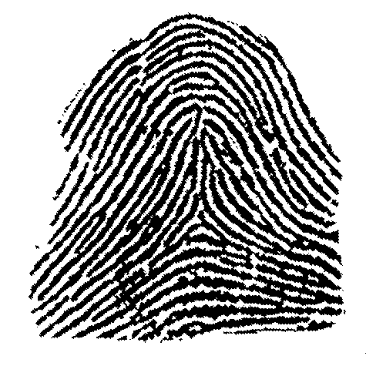
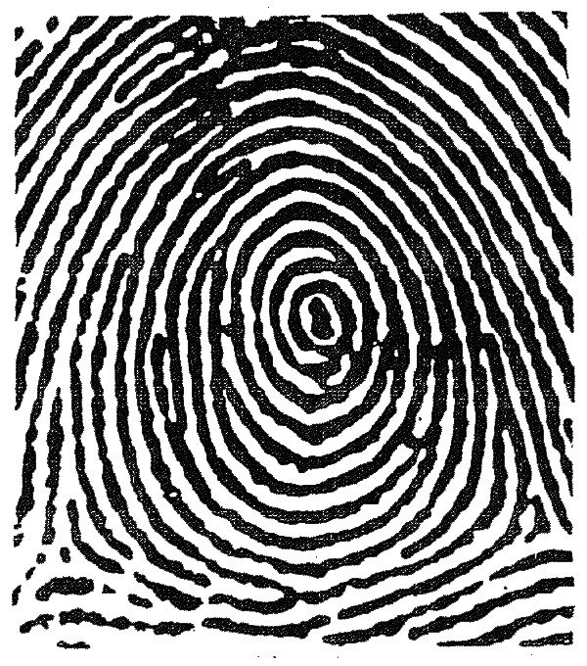
Arches
Whorls
Lines on the fingerprint that start at one side, go to the other, and rise up in the middle
Central circle area with ridges around it. The ridges do not go from one side to the other

Slide 11
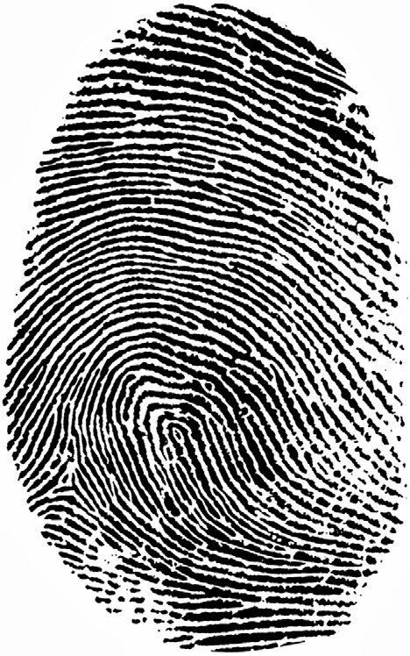
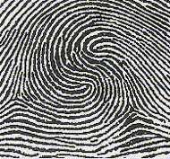
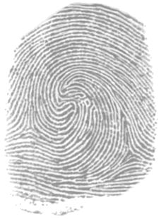
Loop
Composite
Double Loop
Begins at one side of the finger, loops, and goes back to the same side of the finger as it started
Combination of any two fingerprint types on one fingerprint
More than one loop on a single fingerprint

Slide 12
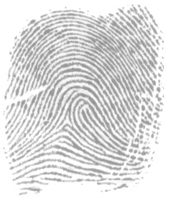
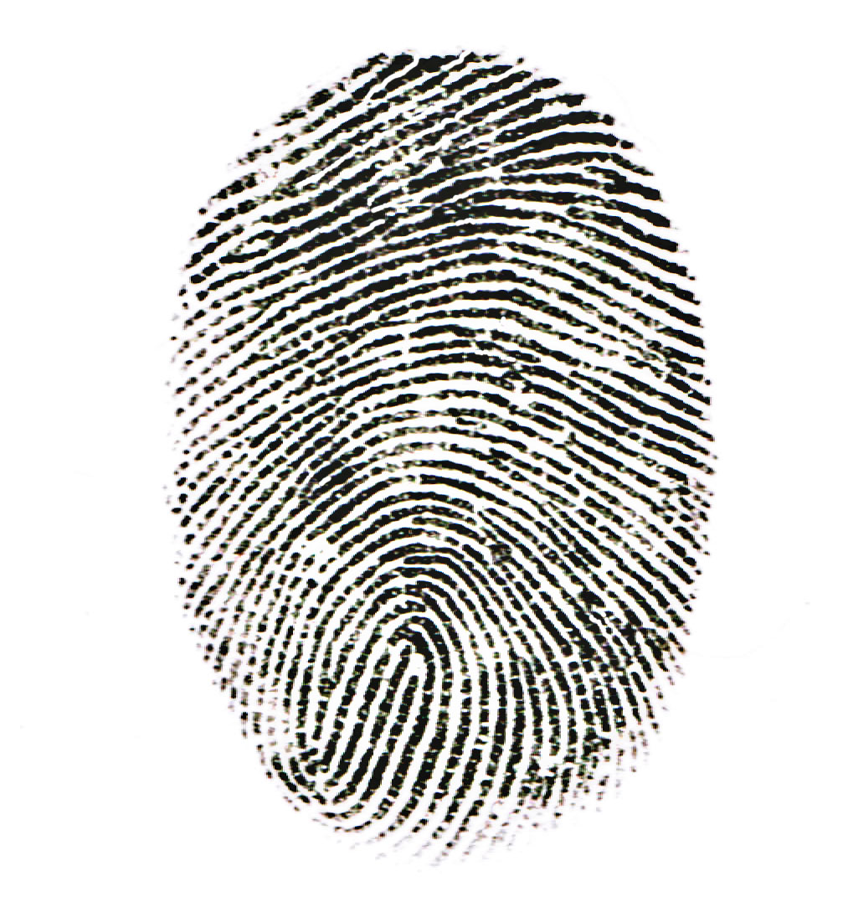
Other things to look for:
Scars
From cuts or burns
Size
Little kids will have smaller fingerprints than adults

Slide 13
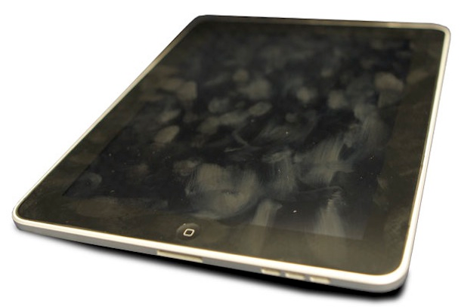
Fingerprints...
Can be easily lifted off of smooth surfaces like glass, mirrors, windows, etc
Can be compared to a witness’s fingerprints, or can be run through a database

Slide 14
Graphology

Slide 15
We use handwriting analysis to identify someone who did, nor did NOT write a note
If a note is left at a crime scene, we can take handwriting samples of suspects and compare the writing
There are 12 main characteristics to look for when analyzing handwriting

Slide 16
Line Quality. Do the letters flow or are they written with very intent strokes.

Slide 17
2. Spacing of words and letters. What is the average space between words and letters.

Slide 18
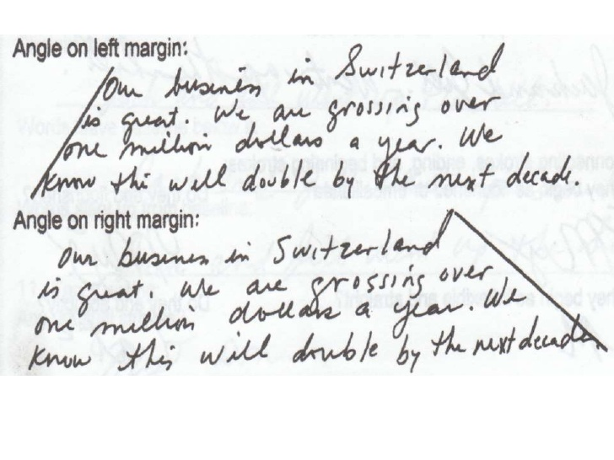

Slide 20
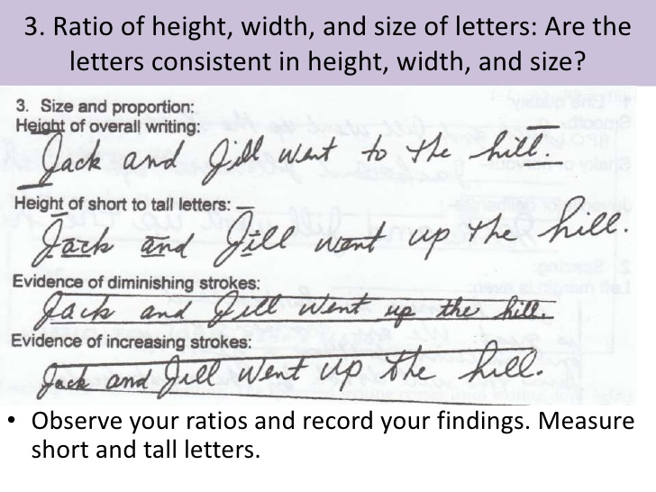
3. Ratio of height, width, and size of letters. Are the letters consistent in height, width, and size?

Slide 21
4. Lifting pen. Does the author lift his or her pen to stop writing a word and start a new word?

