Slide 1
5. Connecting strokes. How are capital letters connect to lower-case letters?

Slide 2
6. Strokes to begin and end. Where does the letter begin and end on a page

Slide 3
7. Unusual letter formation. Are any letters written with unusual slants or angles? Are some letters printed rather than written in cursive?

Slide 4
8. Pen pressure: How much pressure is applied on upward and downward strokes?

Slide 5
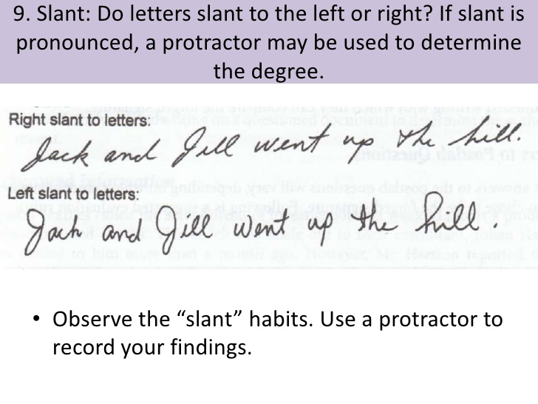
9. Slant. Do letters slant to the left or right?

Slide 6
10. Baseline habits Does the author write on the line or does the writing go above/below?

Slide 7
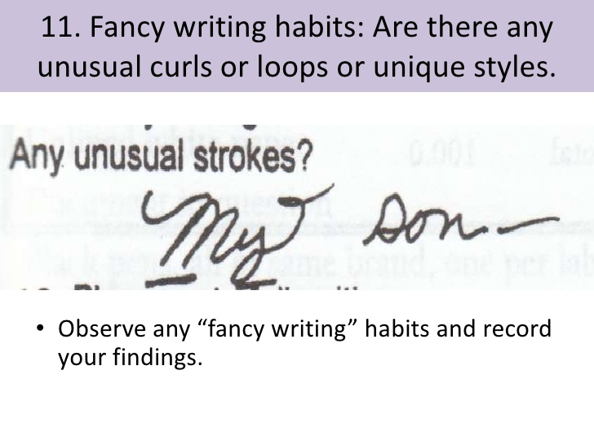
11. Fancy writing habits: Are there any usual curls or loops or unique styles

Slide 8
12. Placement of diacritics. How does the author cross the t’s or dot the i’s

Slide 9
Fabric

Slide 10
Natural Fibres
Made from plant or animals
Include:
Cotton
Wool
Silk
Leather
Linen
Fur

Slide 11
Synthetic Fibres
Man-made using petroleum or other chemicals
Include:
Polyester
Spandex
Lycra
Nylon
Plastic

Slide 12
Tests done to fabrics:
Absorbency Test
Natural fibres will absorb water (think of a cotton t-shirt)
Synthetic fibres will cause water to bead, and slide off (think of a rain coat)

Slide 13
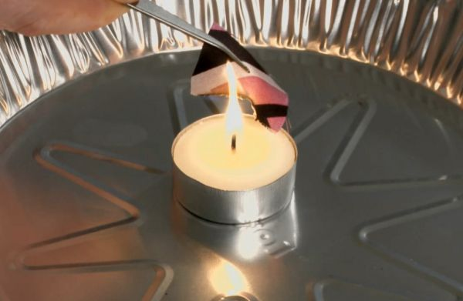
Burn Test
Natural fibres will burn, smell like burning hair, and turn into ash
Synthetic fibres with melt, smell like chemicals, and turn into a hard blob

Slide 14
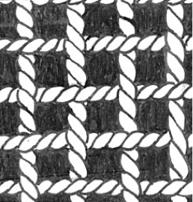
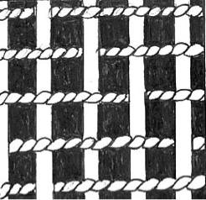
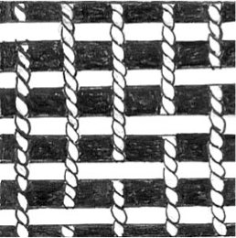
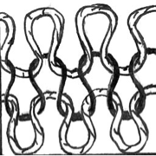
Fiber Comparison
Scientists can look at colour, weave type, and composition of fibres left at a crime scene. Common types of weaves include:
Plain Twill Satin Knitted

Slide 15
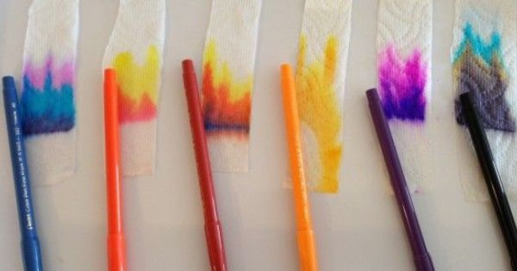
Chromatography

Slide 16
Chromatography is:
A technique used to separate mixtures like ink
It is when a test substance is placed in a medium, and then a solvent is passed through
This causes some of the materials to separate, which can help scientists to determine a type of pen used to write a note at a crime scene, or if a forgery has taken place

Slide 17
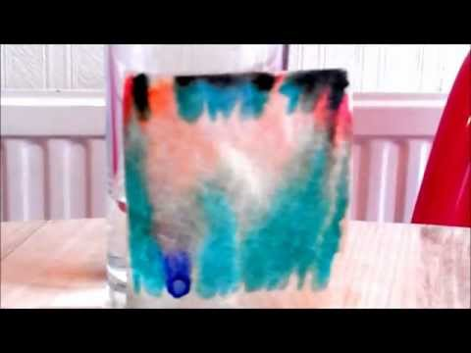
How does it work
The paper that has the ink on it is dipped into the solvent.
The liquid then travels UP the paper, and after a period of time, causes the ink to separate, and “run” on the page

Slide 18
What you need to know
Chromatography is an experiment
The ink should not be in the liquid. Instead, the liquid should travel up the page and pass through the ink
Chromatography can help us to identify a type of ink

Slide 19
Variables
Controlled
Manipulated
Responding

Slide 20
You want to know if adding chemicals to a plant will make it grow faster. You have 3 identical plants. Each day, one plant gets water, one gets water and Coca-Cola mixture, and one gets water mixed with fertilizer. You observe for one week.
Controlled
Manipulated
Responding
Identify the controlled, manipulated, and responding variables.

Slide 21
You want to determine which fabric is the best for keeping you dry at outdoor school. You have 5 different fabrics, and you test each one by spraying it with water for 5 minutes at a time.
Controlled
Manipulated
Responding
Identify the controlled, manipulated, and responding variables.

Slide 22
You want to determine which pen was used to write a ransom note. You do a chromatography test on three different pens.
Controlled
Manipulated
Responding
Identify the controlled, manipulated, and responding variables.

Slide 23
CONTROLLED
MANIPULATED
RESPONDING
What stays the same throughout the experiment
What you change throughout the experiment
What you “find out” from doing the experiment

